Slide 1




Trump's Twitter Rhetoric: Decoding Rhetorical Techniques in Donald Trump's Communication through Text Mining

Slide 2
Purpose
This study analyzes Donald Trump’s communication strategies in his tweets and speeches, focusing on language features like word frequency, unique phrases, sentiment, and key topics, using computational techniques.

Slide 3
Tumasjan et al. (2010) analyzed the predictive power of sentiment analysis in elections using Tweets. Stolcke et al. (2000) developed NLP models to identify speaker intent and rhetoric in political speeches. Pennebaker et al. (2003) examined how word choices reveal psychological states in political texts. Blei et al. (2003) introduced Latent Dirichlet Allocation (LDA) for uncovering thematic patterns.
Literature Review
Grimmer and Stewart (2013) reviewed text-as-data methods for political analysis at scale. Hart et al. (2010) studied rhetorical devices like metaphors and repetition in political messages. Taddeo et al. (2020) explored the ethical concerns of computational propaganda. Graham et al. (2016) investigated social media's role in shaping political narratives.

Slide 4
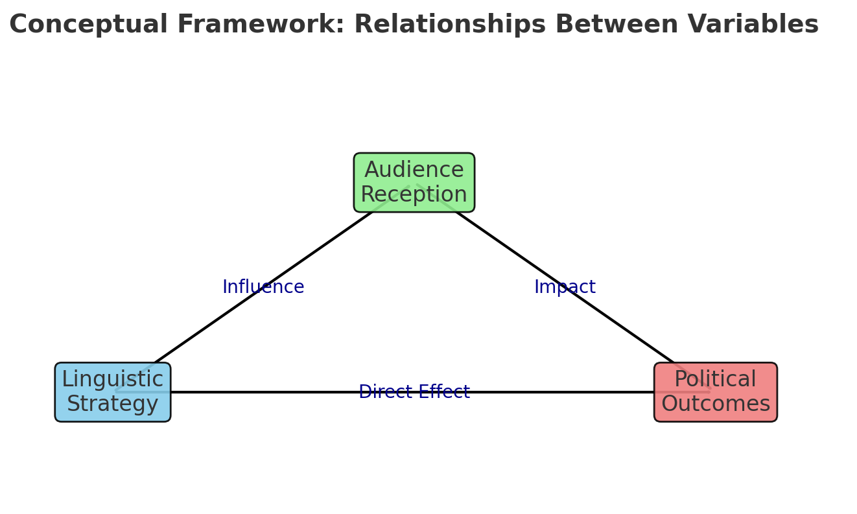
Conceptual Framework
A theory showing relationship between these three variables.
Linguistic strategy
Audience reception
Political outcomes

Slide 5
Research Questions
RQ 1: What are the most frequently used words or phrases in Donald Trump’s speeches and social media communication? (to be analyzed using Term Frequency)
RQ 2: Which words or phrases are most unique to Donald Trump’s communication? (to be analyzed using TF-IDF)
RQ 3: What specific n-grams appear regularly in Trump’s speeches or tweets? (to be analyzed using n-grams)
RQ 4: How does Trump’s use of language vary across different segments based on subgroup-specific emotional responses? (to be analyzed using subgroup comparison)
RQ 5: What categories of words (e.g., emotional, persuasive, ideological) dominate Trump’s communication? (to be analyzed using categorization model)
RQ 6: What are the key topics in Trump’s communication? (to be analyzed using topic modelling)

Slide 6
Name
Location
01
02
Genre
Structure
03
04
Introduction of the dataset
Donald Trump Tweets Dataset
Publicly Available at Kaggle. 11,359KB
Social Media site. Twitter
Rows: 56,571
Columns: 9
It includes tweet text, timestamps, and engagement metrics such as retweets and likes.

Slide 7
Strips punctuation, emojis, and special characters to focus on linguistic content.
URL Remover
Eliminates distractions from external links to prevent bias in sentiment and topic modeling
Removing special characters
Strips punctuation, emojis, and special characters to focus on linguistic content.
1
3
Lower Casing
Converts all text to lowercase for consistency, treating different cases as the same token.
Stopword Removal:
Eliminates common stopwords (e.g., "and," "the," "is") to highlight informative terms
2
4
library(tm)library(wordcloud)library(dplyr)library(RColorBrewer)library(ggplot2), library (syuzhet)
Functions: gsub, tolower, sapply

Slide 8
Tokenization
Finally, the cleaned tweet text was tokenized into individual words. This step is essential for enabling further analyses such as frequency distribution, sentiment analysis, and topic modeling, which will help identify patterns and trends in Trump’s communication style over time.

Slide 9
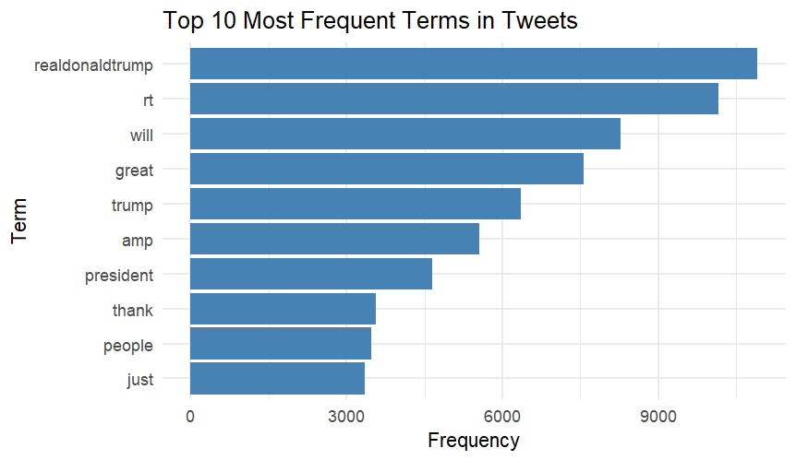
Term Frequency
Frequent words used by Donald Trump's Twitter handle include his own name, "Real Trump" abbreviation, adjectives like "great," and simple terms such as "people" and "president."
This suggests that Trump maintains a straightforward and easily readable style on Twitter.

Slide 10
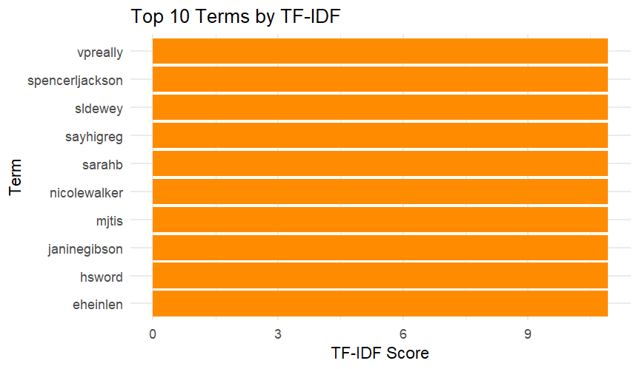
TF-IDF
"VPReally" is one of the 10 unique terms in Donald Trump’s twitter communication. It is a specific hashtag that Trump uses on Twitter
SpencerIjackson is another user who often supports trump in his endeavors.

Slide 11
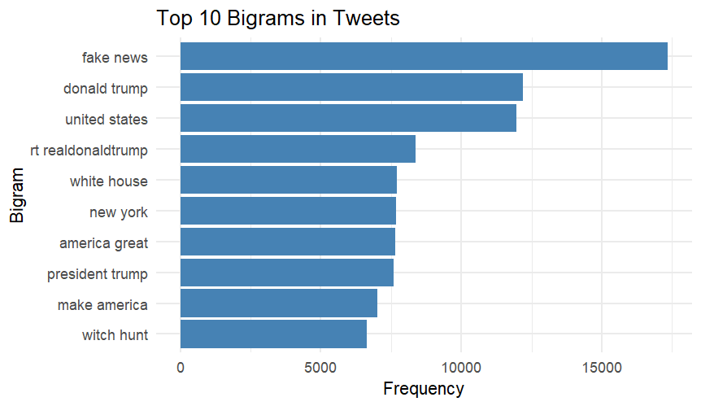
Bigrams
"Bigrams like “fake news”, “Donald trump”, and “united states” are most common in Donald Trump’s tweets.
Others are also related to his presidency mostly.

Slide 12
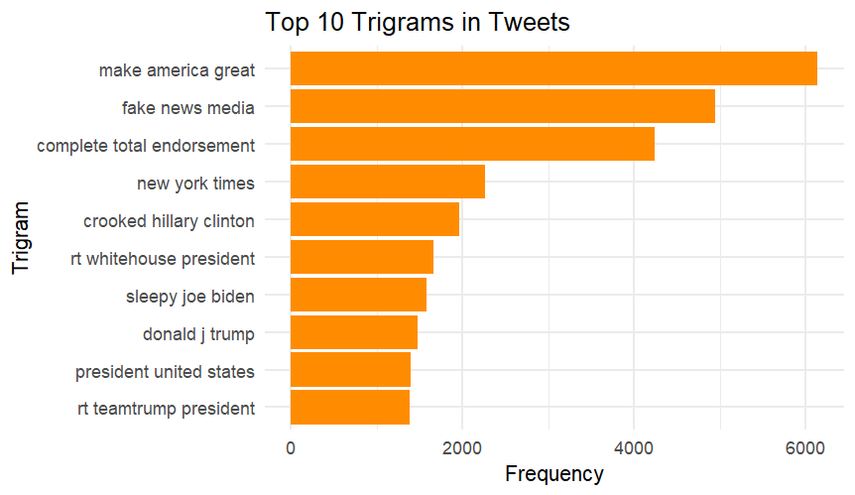
Trigrams
trigrams such as “Make America Great”, “fake news media”, and “crooked Hillary Clinton” are also common in his twitter, at least up until 2021. The presence of these words are somewhat obvious as “fake” and “news” would go together.

Slide 13
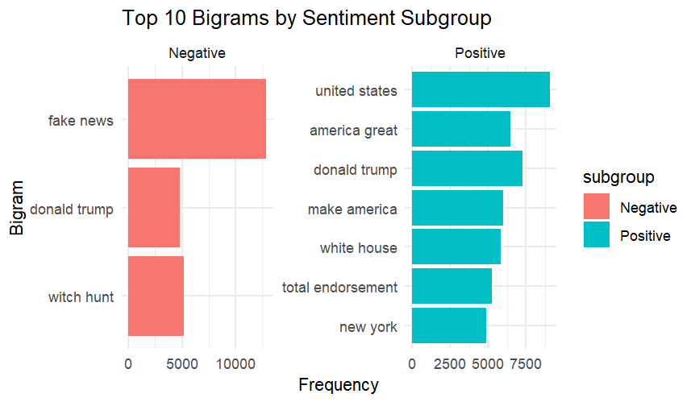
Bigrams by Sentiment subgroup
media criticism ("fake news") and personal attacks ("witch hunt").
Positives resonate patriotism and American people’s dreams/ambitions.

Slide 14
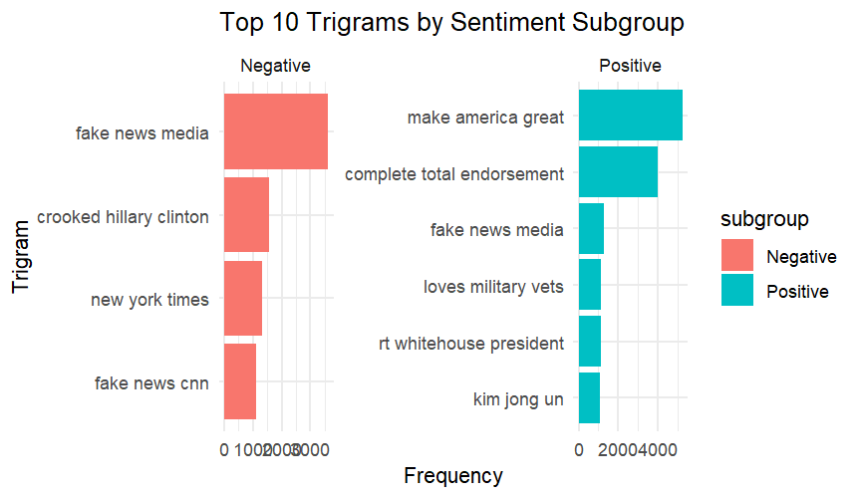
Trigrams by Sentiment subgroup
Similar to the bigrams, the negative trigram subgroup primarily focuses on media criticism, personal attacks on political opponents, and distrust of news organizations. On the other hand, the positive trigram subgroup highlights themes of patriotism, political support, and military backing,

Slide 15
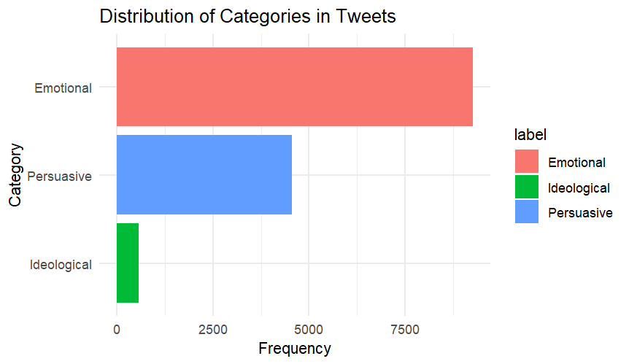
Categorization
Donald Trump uses emotional language strategically to capture attention, engage his audience, and amplify his message. By employing emotionally charged words, he simplifies complex issues, making them more relatable and impactful, while also mobilizing support and strengthening loyalty among his followers

Slide 16
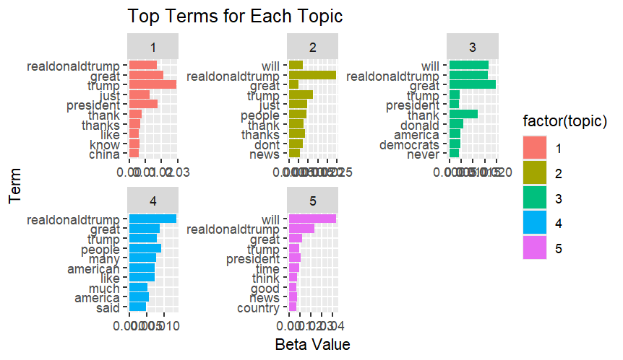
Topic Modelling
•Topic 1 captures terms related to Trump's role as president and his core supporters, like "president", "thank", and "great-trump".
•Topic 2 is more focused on Trump's relationship with the public, using terms like "will", "great-trump", and "people".
•Topic 3 touches on Trump's political standing, with terms like "democrats" and "never".
•Topic 4 reflects public perception of Trump, including phrases like "american-like" and "much-america-said".
•Topic 5 contains more general terms about time, thinking, and news.

Slide 17
-Trump’s tweets feature simplified language, emotional appeals, and repetitive phrases, making his messaging accessible and memorable. -His use of emotionally charged terms, along with themes like patriotism, media criticism, and personal attacks, constructs an "us vs. them" narrative to engage supporters and polarize public opinion. -Sentiment analysis and topic modeling show how Trump tailors his tone and themes, balancing positive and negative rhetoric to appeal to a broad range of followers. -By using memorable bigrams, consistent self-branding, and adaptive rhetoric, Trump amplifies his messages effectively on Twitter, a platform defined by brevity and immediacy. -The study highlights the role of strategic linguistic choices in digital political communication, especially in a polarized and fast-paced media environment. -Future research could explore the long-term effects of these strategies on political polarization, voter behavior, and trust in media and institutions.
Conclusion

Slide 18
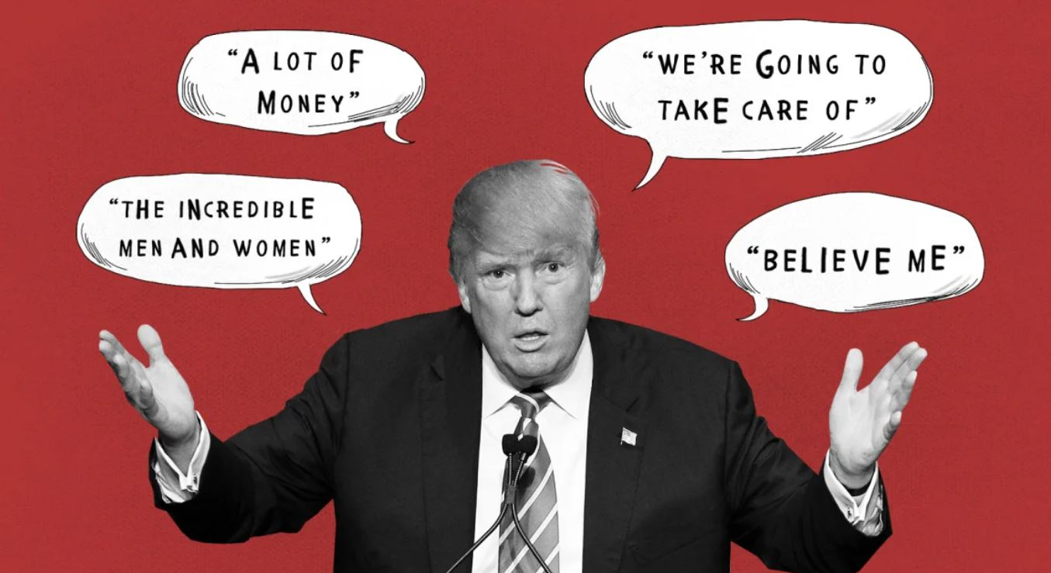
Simplified Language for Broader Appeal Emphasis on Self-Branding Strategic Use of Emotional Language Focus on Memorable Phrasing Sentiment-Based Messaging Differentiation Balance Between Emotional and Persuasive Content Topic-Specific Messaging Consistency in Hashtags and Handles Adaptive Messaging Strategies
Recommendation

Slide 19
Expand the Analysis Beyond Just Twitter Data Conduct Longitudinal Analysis – Study over time Explore Cross-Platform Comparisons – Exploring other platforms Investigate the Impact on Political Outcomes Expand the Categorization Model – Nationalism, anti-establishment attitude Incorporate Multi-Modal Analysis – memes, images Explore International Comparisons – Other similar leaders Consider Ethical Implications – Check whether this should be allowed
Future research

Slide 20
THANK YOU

